Slide 1


Fedora Websites 2022
A joint effort towards enhancing Fedora Project’s web experience
Mairin Duffy
Lead, Fedora Design
Senior Principal Interaction Design, Red Hat
Sayak Sarkar
Fedora Websites and Apps Team
Principal Software Engineer, Red Hat

Slide 2
What is this talk about, and what is it not about?
It's about Fedora's websites.
Not the web apps & infrastructure apps.

Slide 3
What is our story*?
* the big picture of what exactly Fedora is, and why and how would one want to use it.

Slide 4
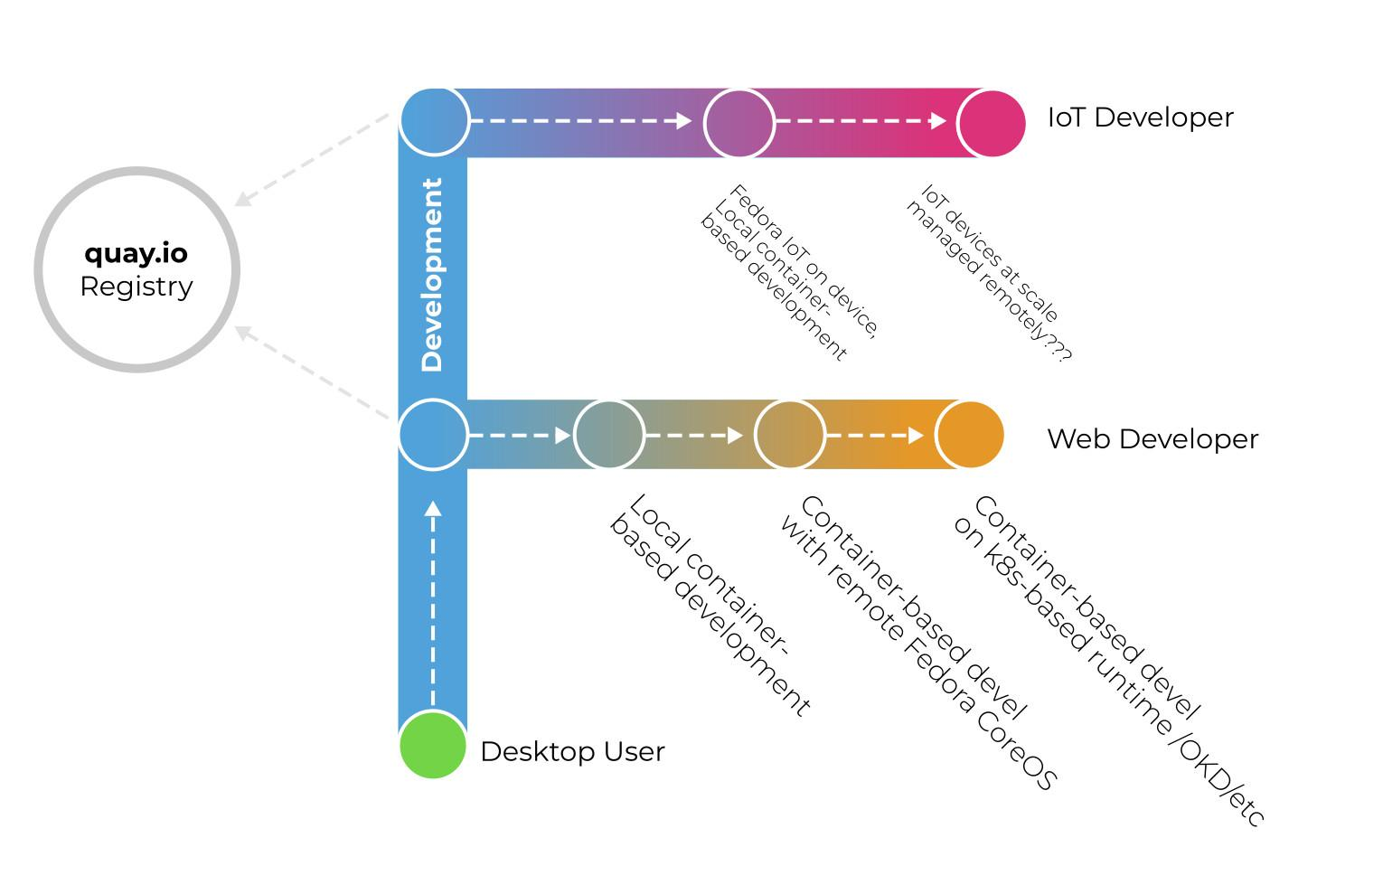
Fedora Linux's Conceptual Model
(AKA our story for what we deliver)
Read more about this: tinyurl.com/fedora-concept

Slide 5
Fedora's Community
(AKA our story for our community)
Fedora is a community; Fedora Linux is our OS.
Read more about this: tinyurl.com/fedora-naming
The Fedora Project envisions a world where everyone benefits from free and open source software built by inclusive, welcoming, and open-minded communities.
Fedora's Vision Statement

Slide 6
How do we tell our story?

Slide 7
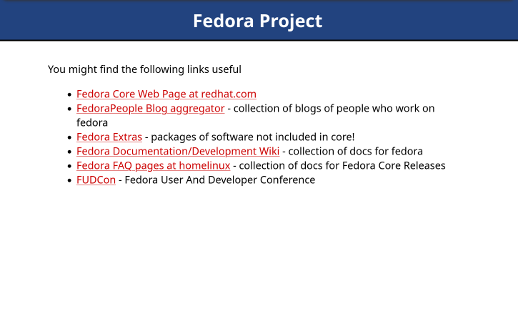
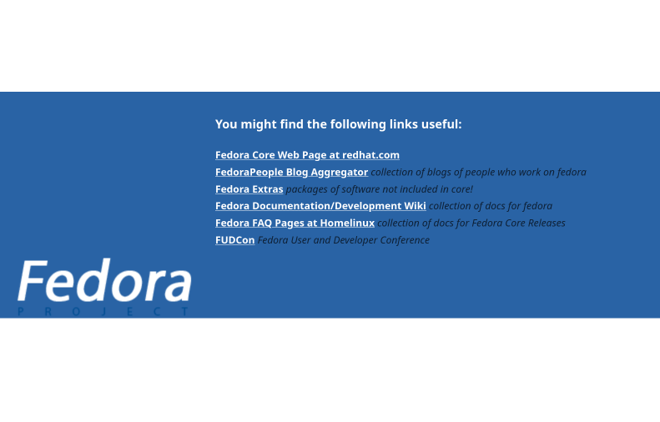
Fedora's Website: A Timeline
December 2004
Phase #1: Link Dump
The Fedora Project was new, and the website was just a list of links. Not very exciting. Note the slightly-less ugly version of the link dump that went live in August 2005 uses the very first Fedora logo - a simple logotype based on Myriad Pro.
August
2005

Slide 8
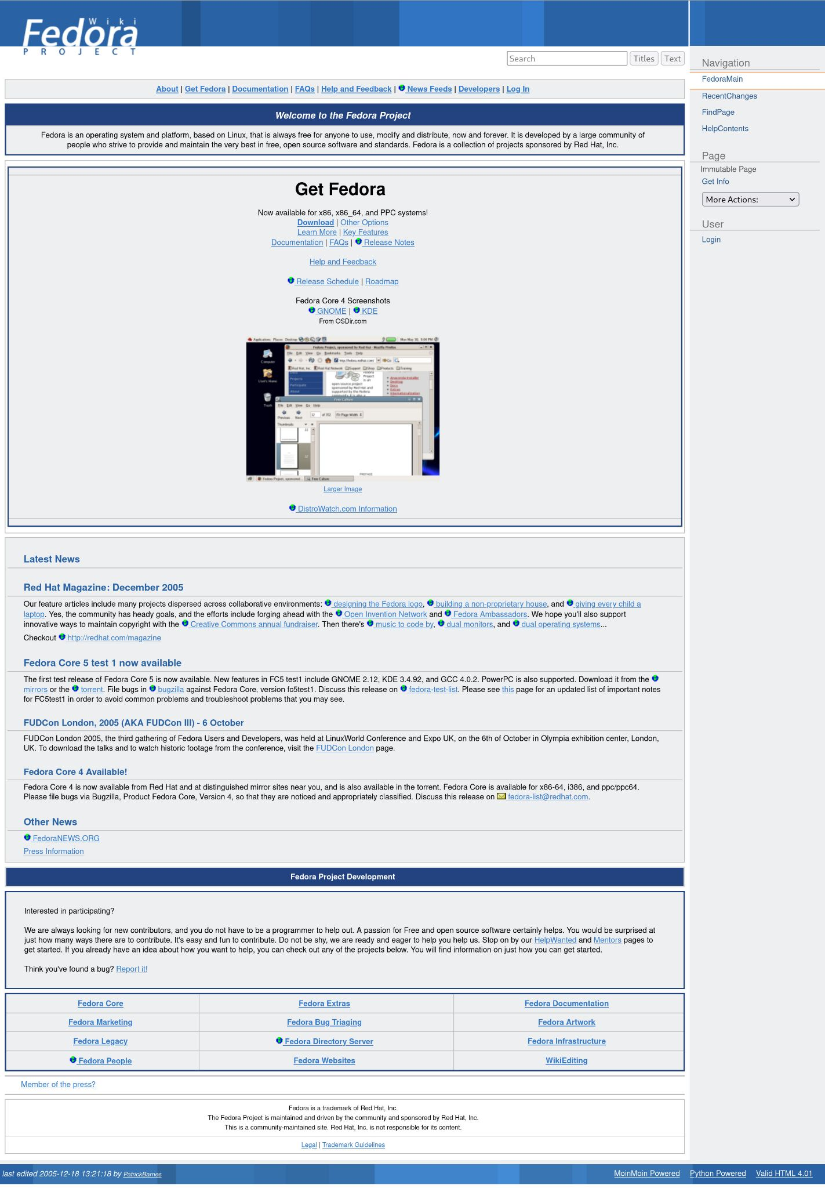
December 2005
Phase #2: Redirect to wiki
Back in the days when "Photograph" by Nickelback was in constant play on the radio… We had Moinmoin set up - there was a CMS evaluation (which included Drupal) and Moinmoin was selected for being written in Python and being relatively simple. Performance became an issue, though…

Slide 9
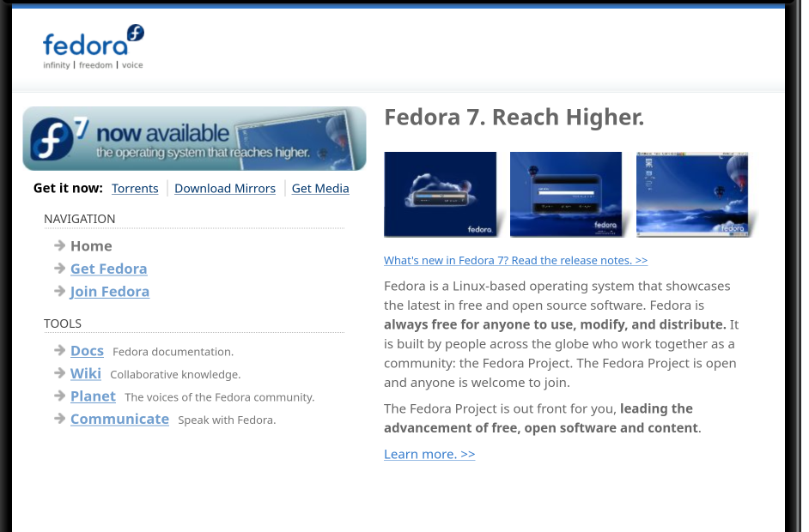
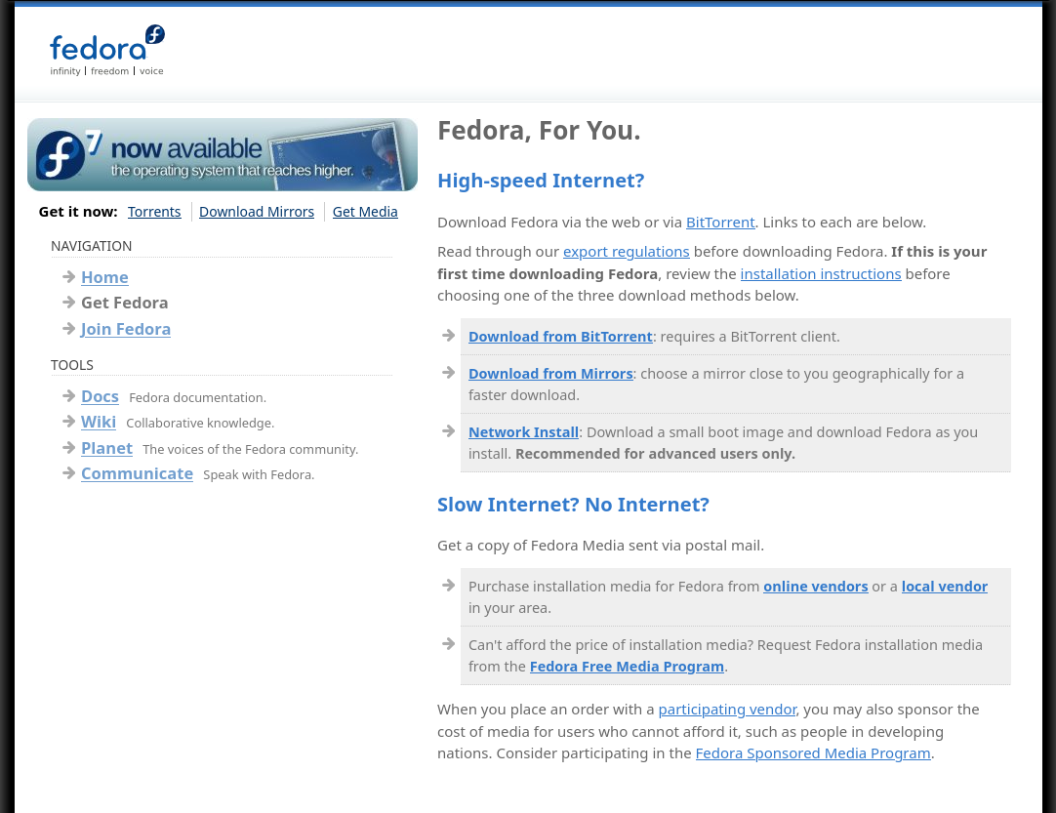
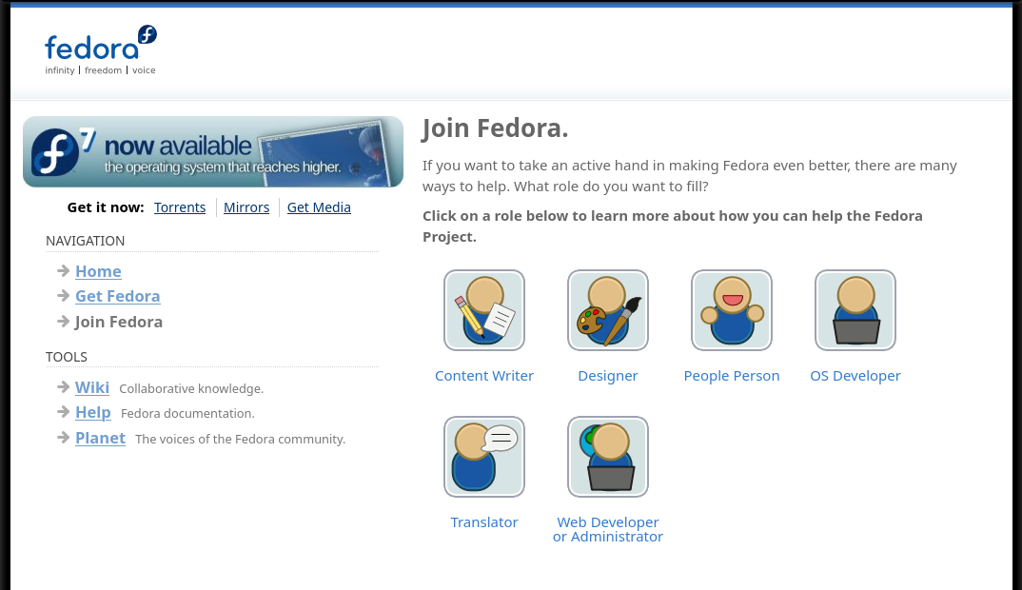
May
2007
Phase #3: First actual (3-4 page) site
Because the wiki's performance serving as the primary website for Fedora wasn't too great, we decided to have a static website (generated by Plone.) It was modest but it was ours!
April 24, 2007 post on Plone & static content on websites-list@fedoraproject.org
Notes from Fudcon Boston 2007 planning session for redesigning the website

Slide 10
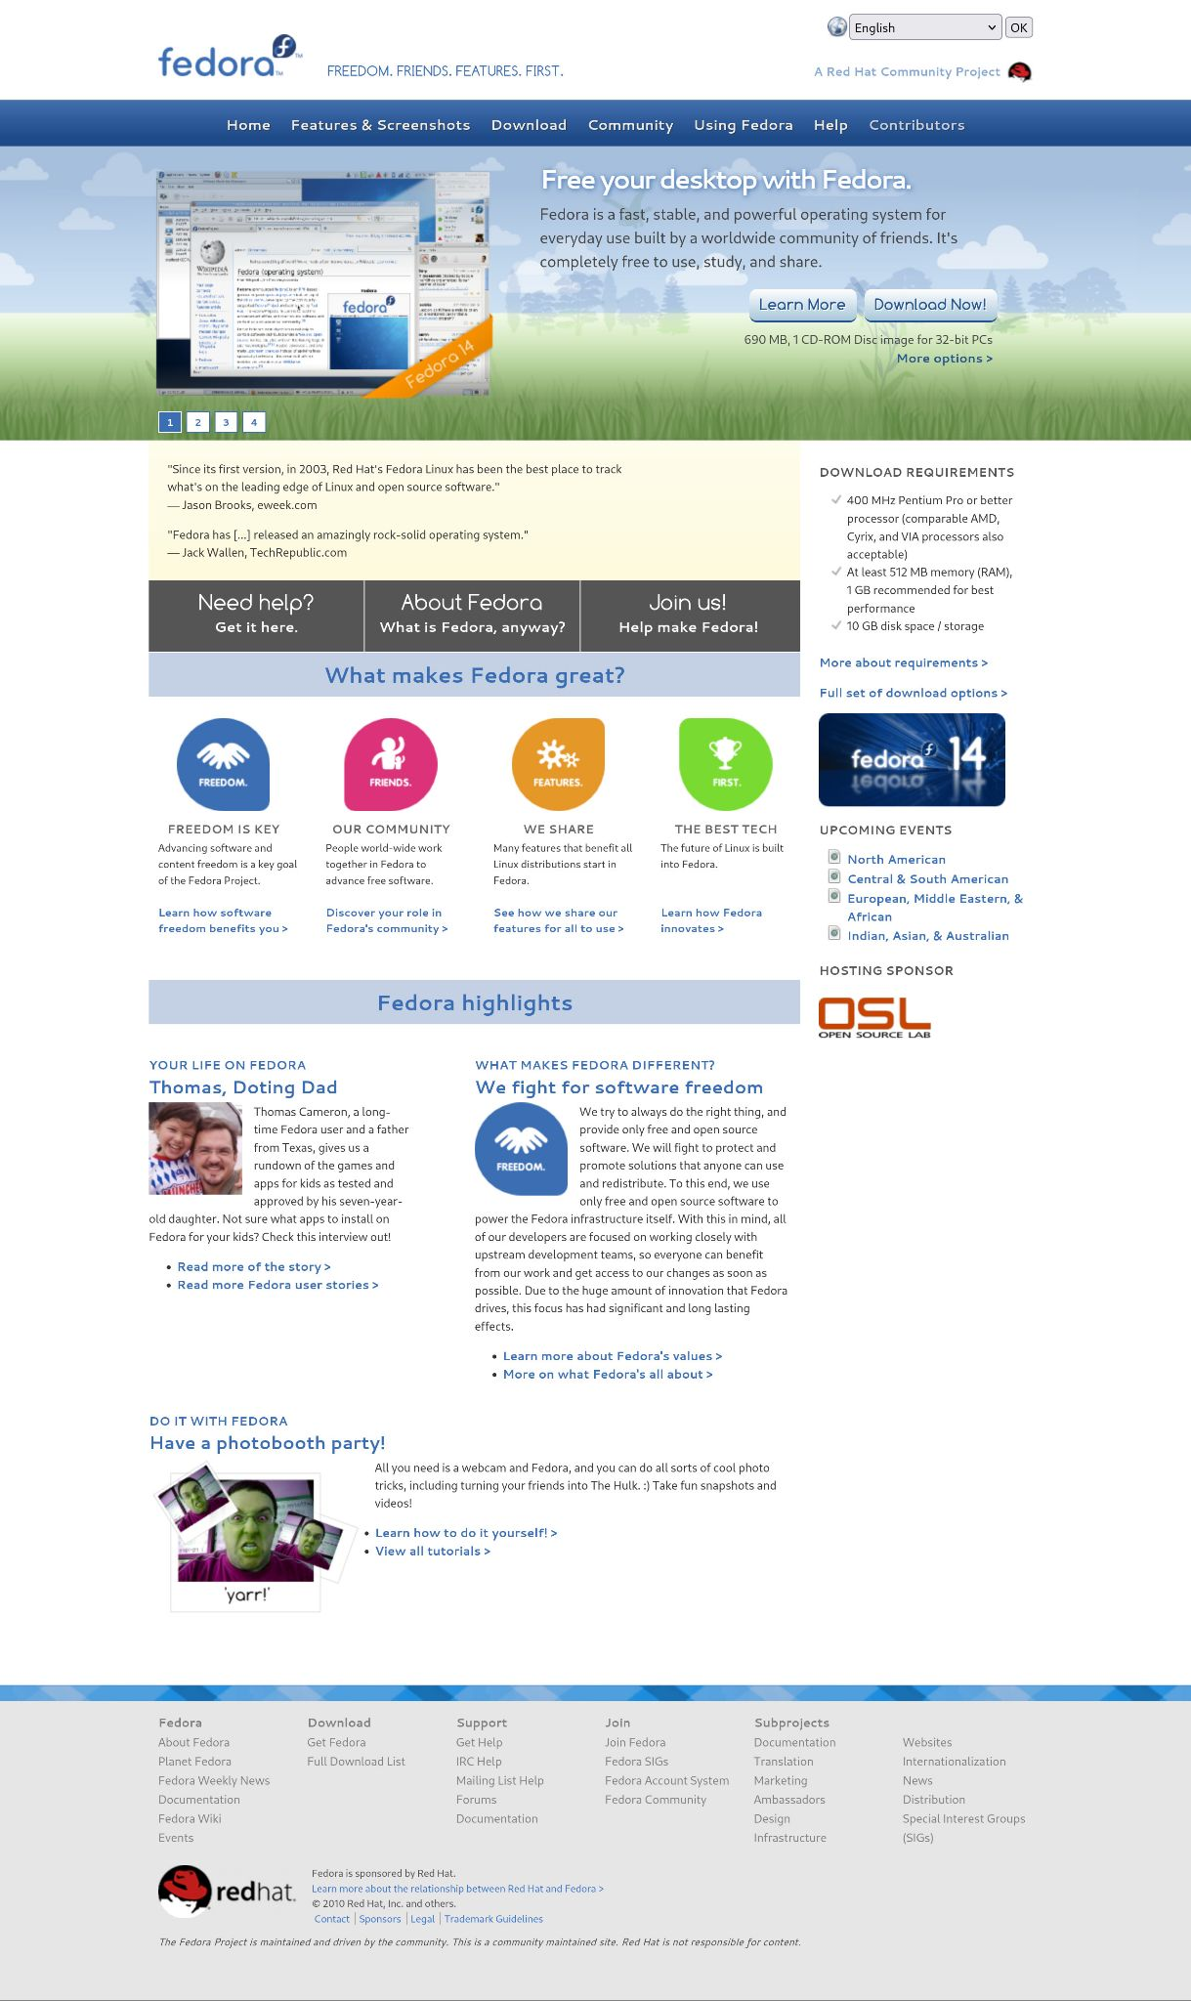
October
2010
Phase #4: First Serious Website
Using a Python-based system (using Jinja templates) we rolled out a major redesign of the website - the design and implementation process started in 2009 and took roughly a year. It had Fedora Magazine-like articles but before FM existed; it was not backed by a CMS, and the content grew stale over time.
Early mockups and site map plans for wwwfpo 2009 redesign

Slide 11
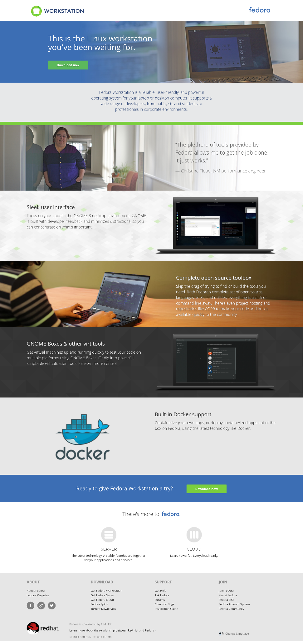
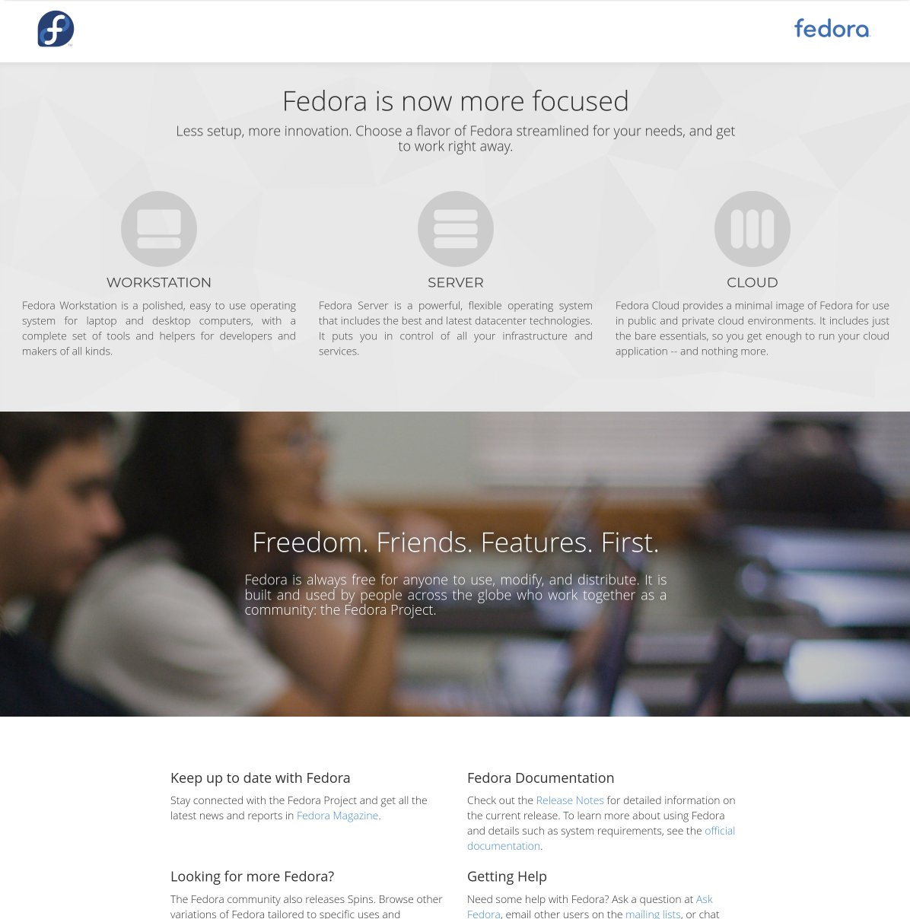
Phase #5: Edition-Centered Brochure Site (The Big Split)
December
2015
We made Fedora website into a user-centric "brochure" site focused on the various Fedora editions in 2015. The idea was to host the user portion (the "front door") at getfedora.org and the contributor-centric portion (the "back door") at fedoraproject.org, backed by a custom collaboration platform we worked on called Fedora Hubs. (We later abandoned the Hubs project.)
Spins, Labs, Arm, and other sub-domain-based sites were created for non-Edition content.
Website redesign 2015 proposal blog post

Slide 12
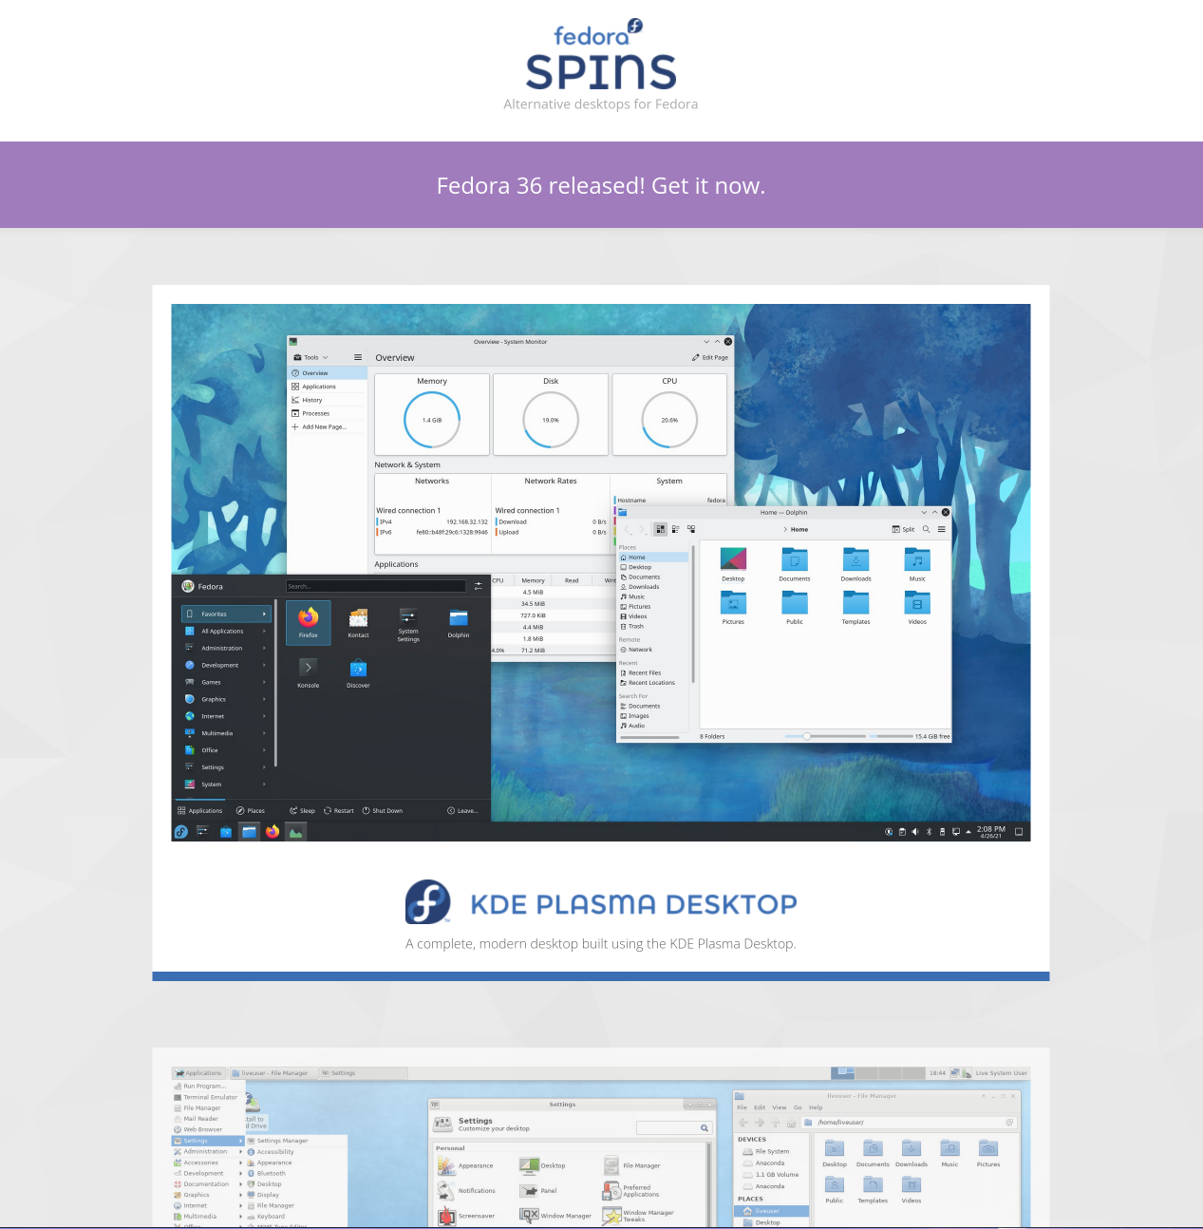
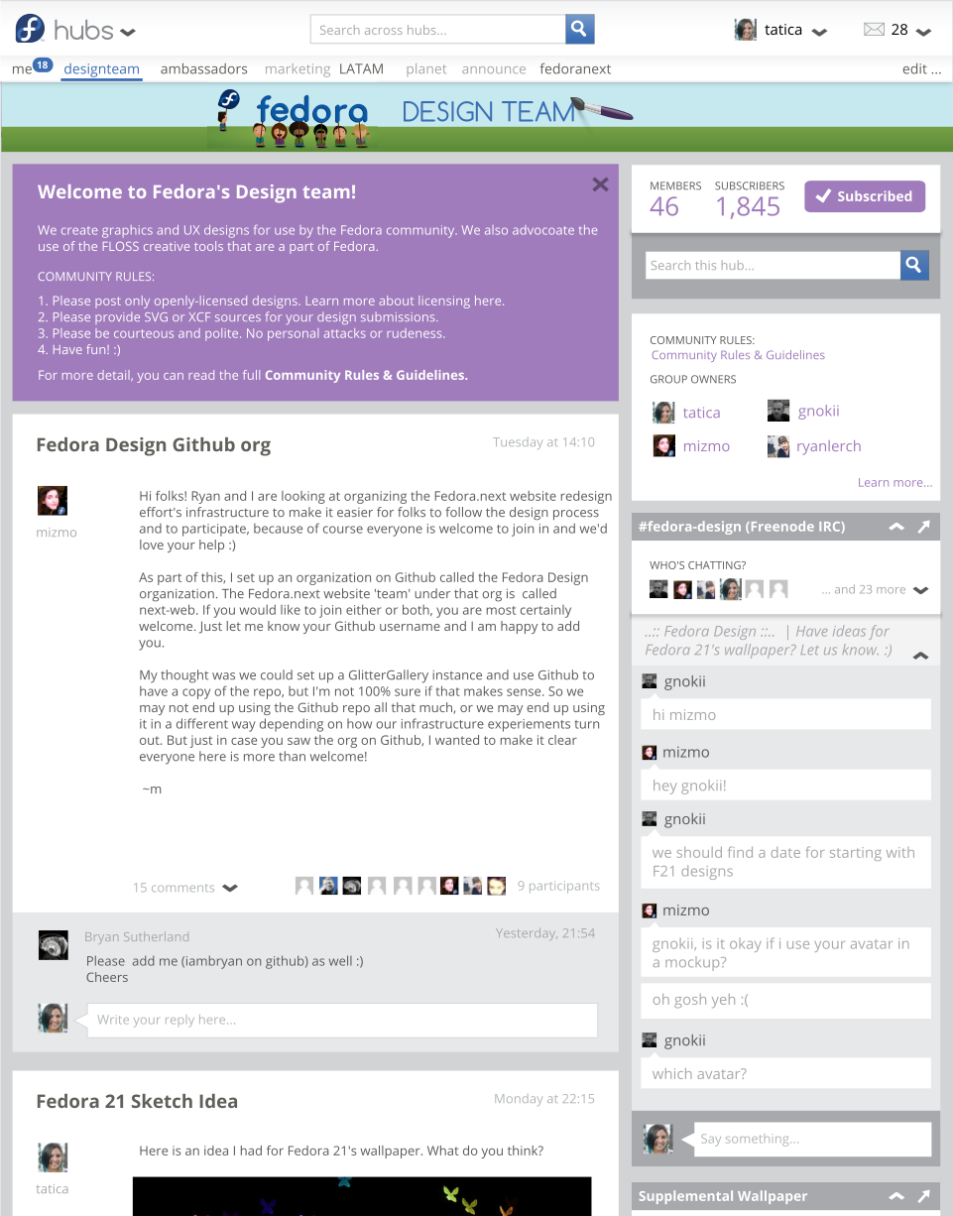
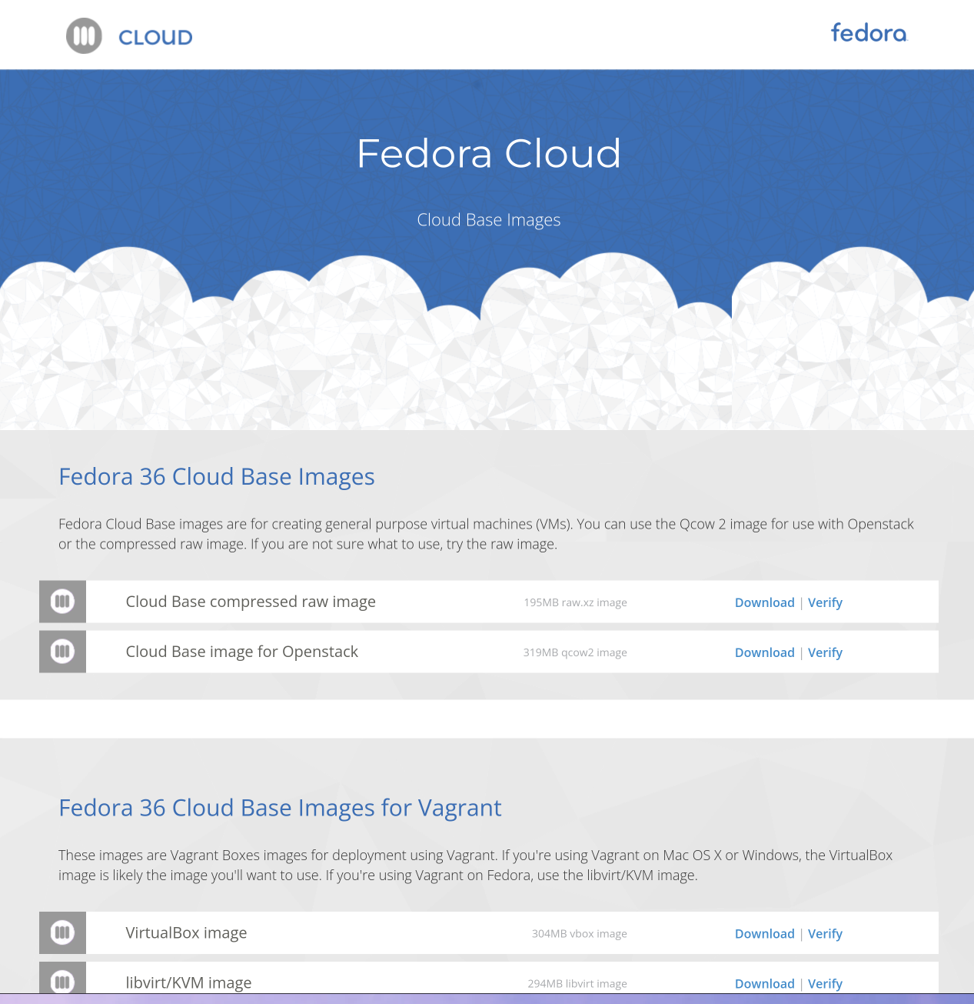
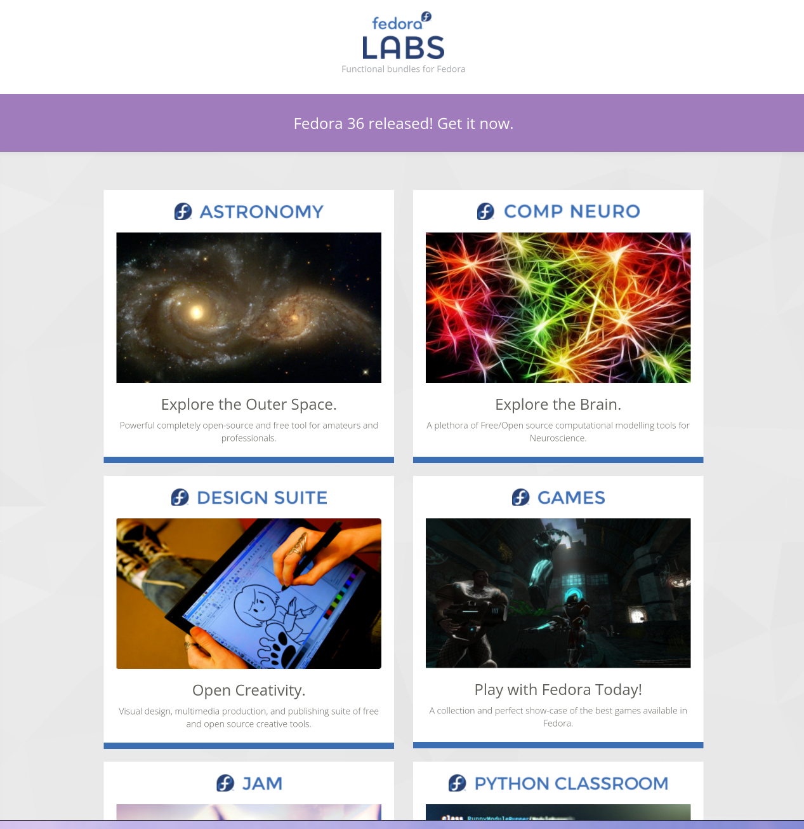

Slide 13
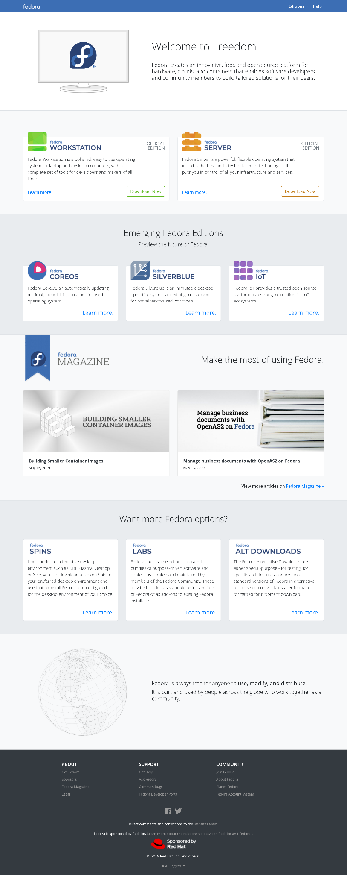
May
2019
Phase #6: Today's Fedora Website
This was a revamp of the website implementation to use static site generation tools, and to make it easier to contribute to the website design and content. The top-page is less of a splash and more designed with integrated Fedora magazine content.
Many sub-domain sites exist still, and contributor content is focused elsewhere.
Redesign discussion
2020 Redesign Document

Slide 14
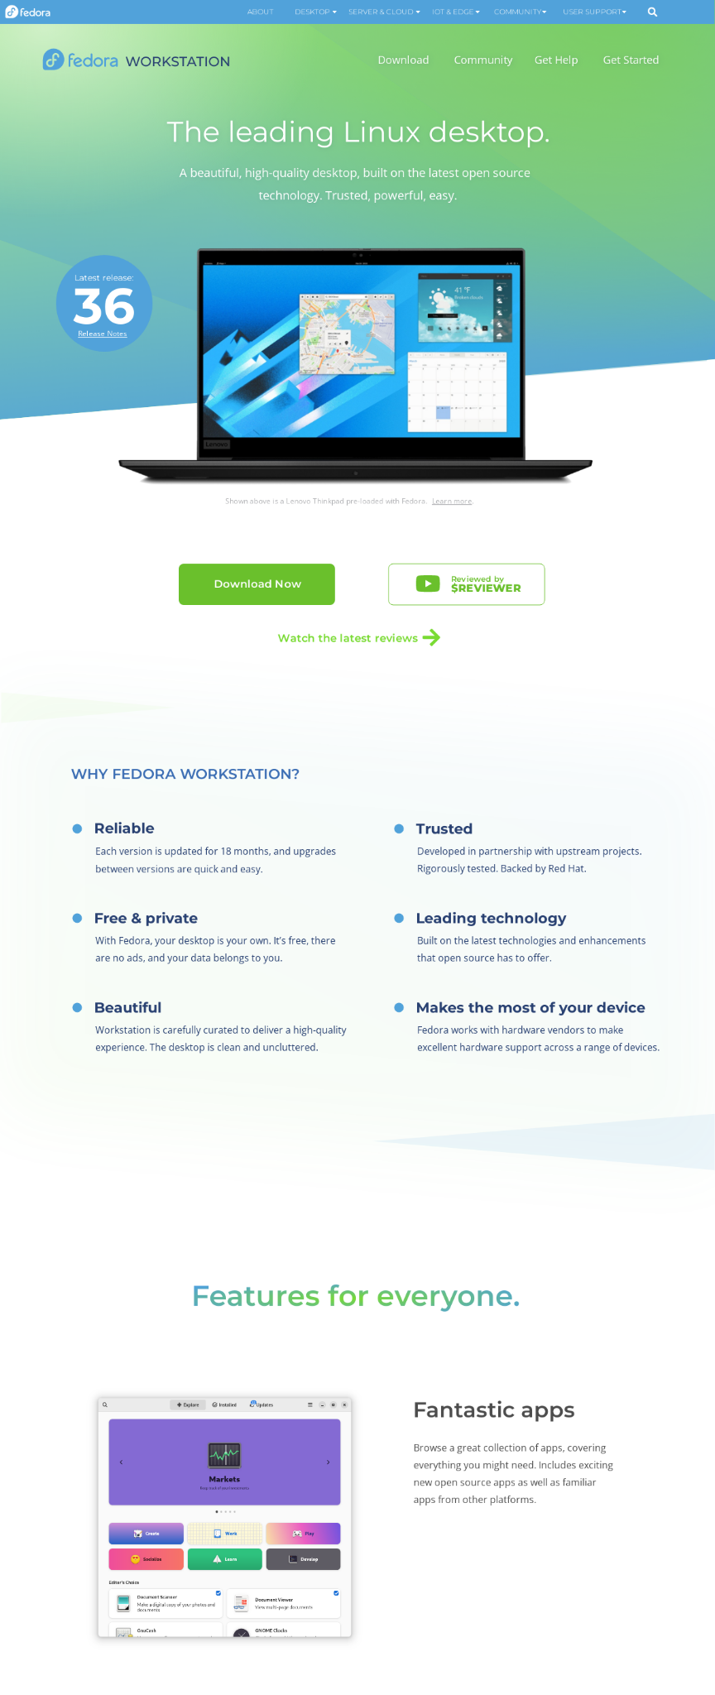
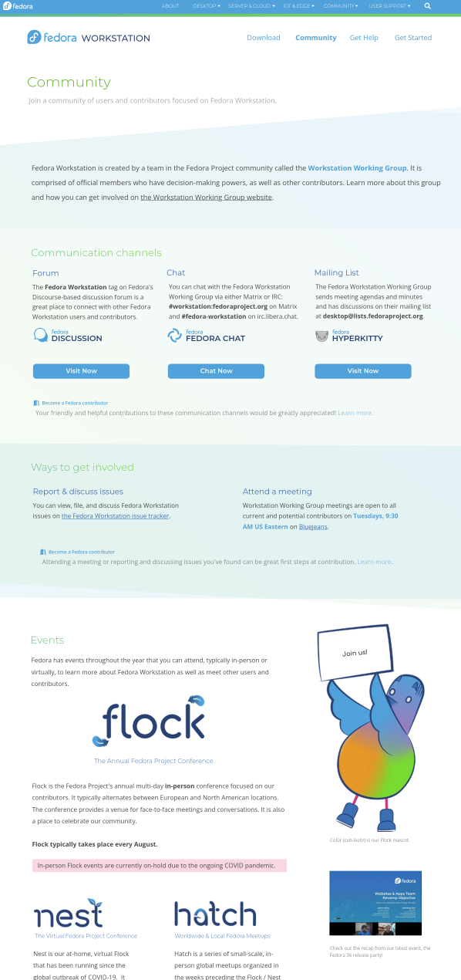
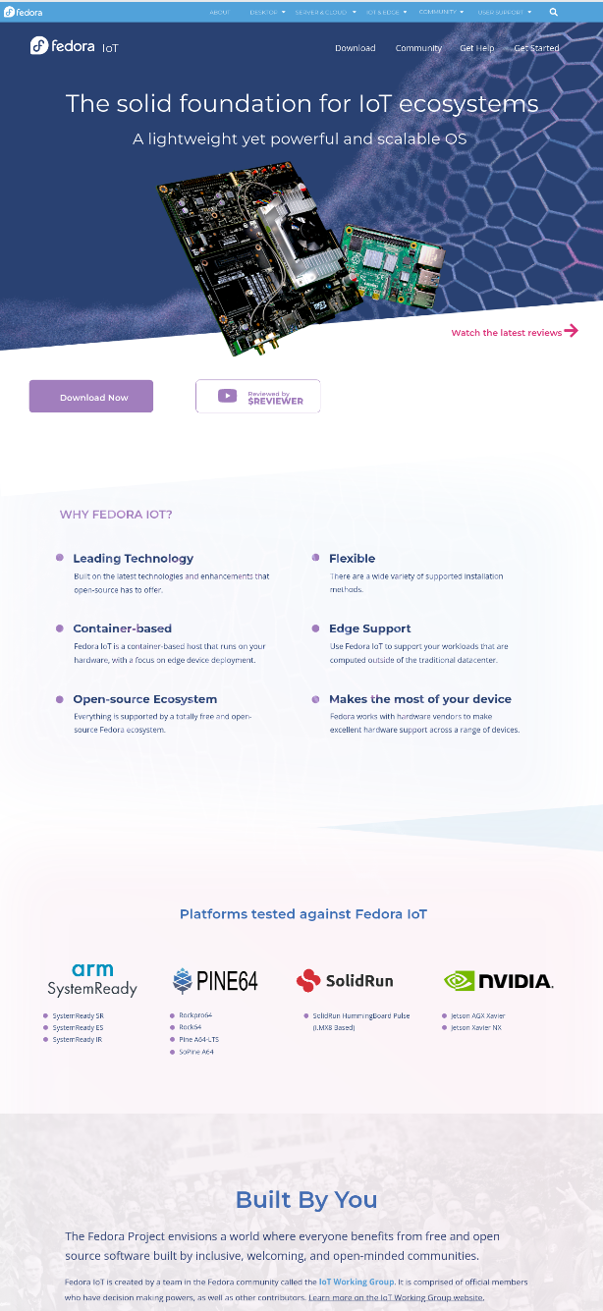
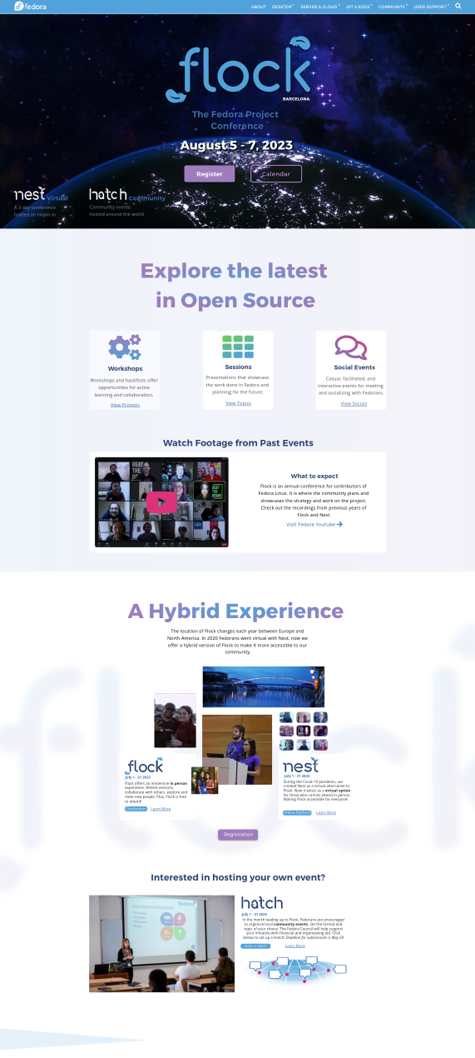
Phase #7: Fedora Website 2022
The Future

Slide 15
Themes
What have we learned about our website requirements up through now?
Performant & Secure
Managed Content
Fun to contribute to
Flexible / Expandable
We had to switch platforms from a moinmoin wiki to other lighter-weight systems because of performance issues. Our website gets a lot of traffic. We need to perform well without requiring a lot of resources or posing security risks.
We've had content go completely stale (by years!) because editing and maintaining existing content and contributing new content was too high a bar, involving git and other code-oriented workflows without a user-friendly Content Management System.
We want to build a healthy community team around our website and choose an approachable tech stack that makes it as easy as possible for web developers and designers to contribute to building and maintaining the website. It should be fun!
One of our major website redesigns was necessary because the older design wasn't flexible enough to allow for the change in Fedora offering multiple editions. The website needs to be built in a modular way where it can flex to changes in Fedora.

Slide 16

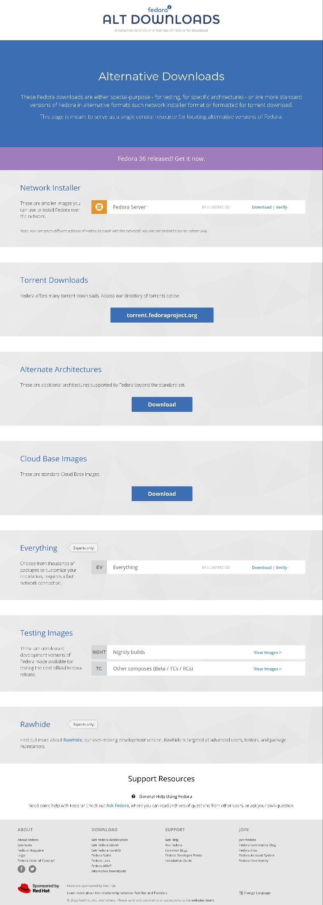
The Big Fedora Linux Split
Fedora Editions
All other Fedora Linux

Slide 17
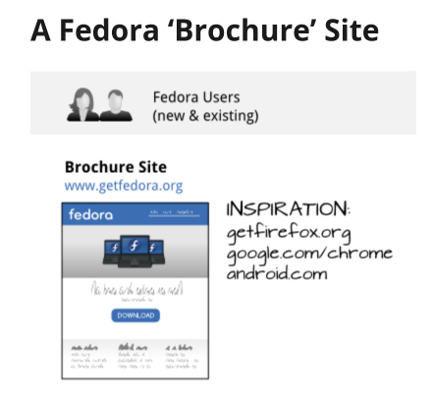
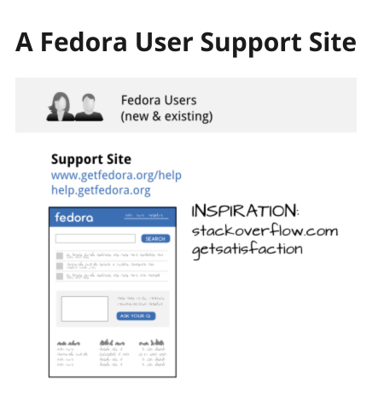
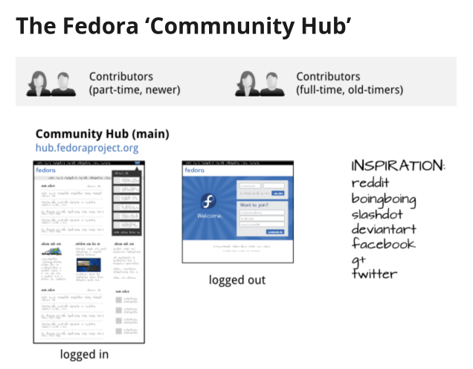
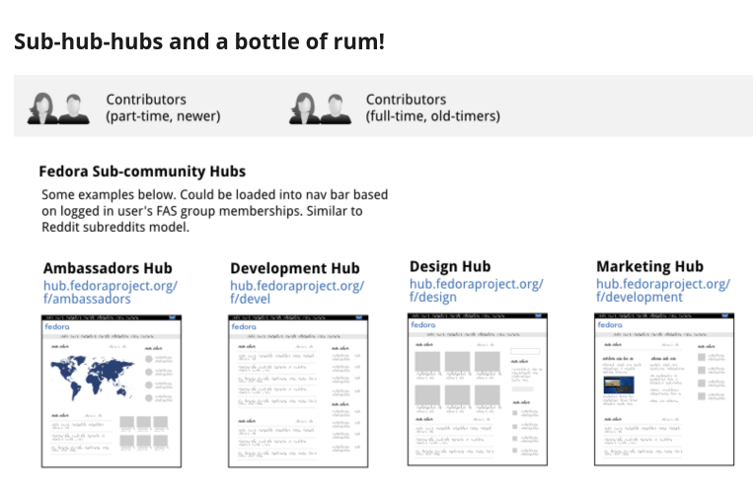
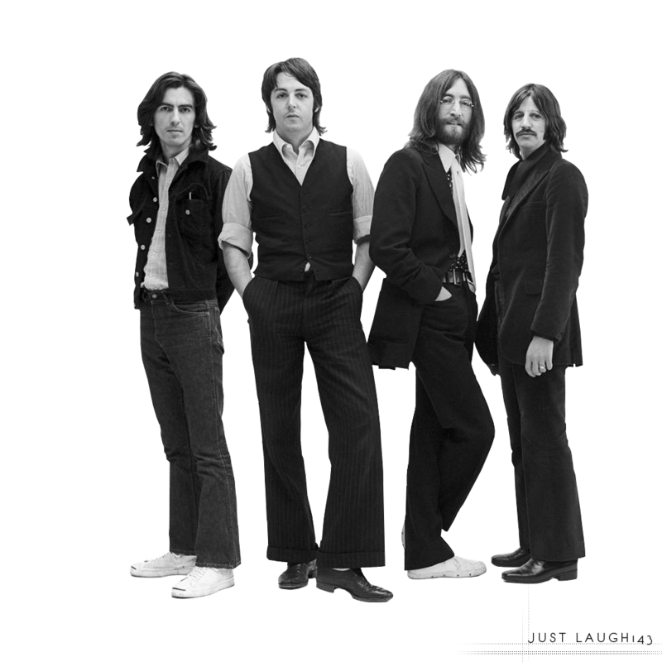
The Big Community Split
Users
Contributors
Time to get "the bands" back together again, unified by a focus on our conceptual model.

Slide 18
How are we building it?

Slide 19





Our new platform
Vue.js
Vite.js
Nuxt.js
Netlify CMS
Tailwind CSS
A modern and accessible Javascript framework for building frontend components.
A next-gen build tool.
A rendering framework built on vue that will enable us to build our sites statically.
A headless CMS that provides a simple UI for adding & editing content with a git-based workflow.
A utility class CSS framework.
Intern Ashlyn Knox evaluated multiple platforms including Vue.js, React, and Fast API in different configurations and the Websites & Apps team has collaborated together on and rallied around this platform.
https://gitlab.com/fedora/websites-apps/fedora-websites/fedora-websites-3.0

Slide 20



Current Status Part 1
Create design mockups
Develop on the code
Add/Edit/Finalize Content
Once we are done with multiple rounds of feedbacks from the community, we establish a final set of mockups that need to be implemented.
With the decided set of mockups, we convert them into interactive proof-of-concepts by building the relevant frontend and backend elements.
As the initial website platform & CMS become ready for use, we'll start entering in the content for all the website sections and prepare it for translation.
In progress
In progress
Starting soon

Slide 21



Current Status Part 2
Set up staging & gather feedback
Facilitate on the finale
Documentation
Set up a staging deployment to test waters in the community on the work done so far with the new builds. Solicit community feedback and iterate based on the findings.
With the included set of improvements, we keep updating the staging and soon enough, production environment from time to time.
As progress is made, each step gets documented to pave the way for new contributors to join in the effort and for facilitate maintenance into the future.
In progress

Slide 22


Where do we start?
We start small and build up to more complex targets.
Flock To Fedora
Start
The website is about Flock, Nest, Hatch and other such events. As the work on it is in progress and scope of the project is (comparatively) smaller - it can be a great starting point.
This website is a landing page for Fedora’s default selected browser where it aggregates news articles from Fedora Magazine and shows useful links. The smaller scope can be welcoming for starters.

Slide 23

Get Involved
Matrix Chat
Meetings
New Contributor Training Opportunities
#websites:fedoraproject.org on chat.fedoraproject.org
Every Tuesday at 1500 UTC
Jitsi meeting link: https://meet.jit.si/fedora-websites-apps-meeting
We have two types of new contributor training planned:
Creating components for Fedora's website using Vue.js: A video-based training that will walk you through how to create a component step-by-step and get you on a good start to contributing to frontend!
Hackfest & video training for content entry: Help us add and edit content to the websites - this training will guide you on how to use netlify CMS to submit content to the website!
The code
gitlab.com/fedora/websites-apps/fedora-websites/fedora-websites-3.0
Our documentation
docs.fedoraproject.org/en-US/websites

Slide 24

Scan the QR code to view our documentation https://docs.fedoraproject.org/en-US/websites/

Slide 25

Scan the QR code to join our channel https://chat.fedoraproject.org/#/room/#websites:fedoraproject.org

